Slide 1
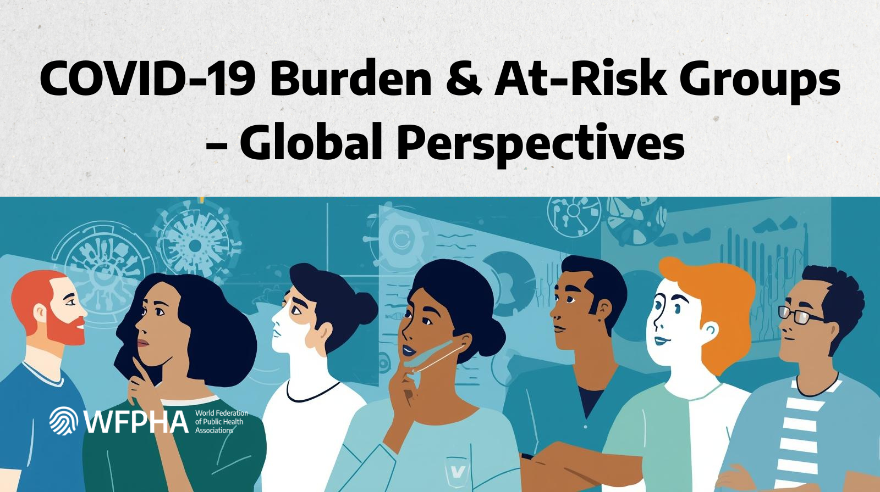

Slide 2
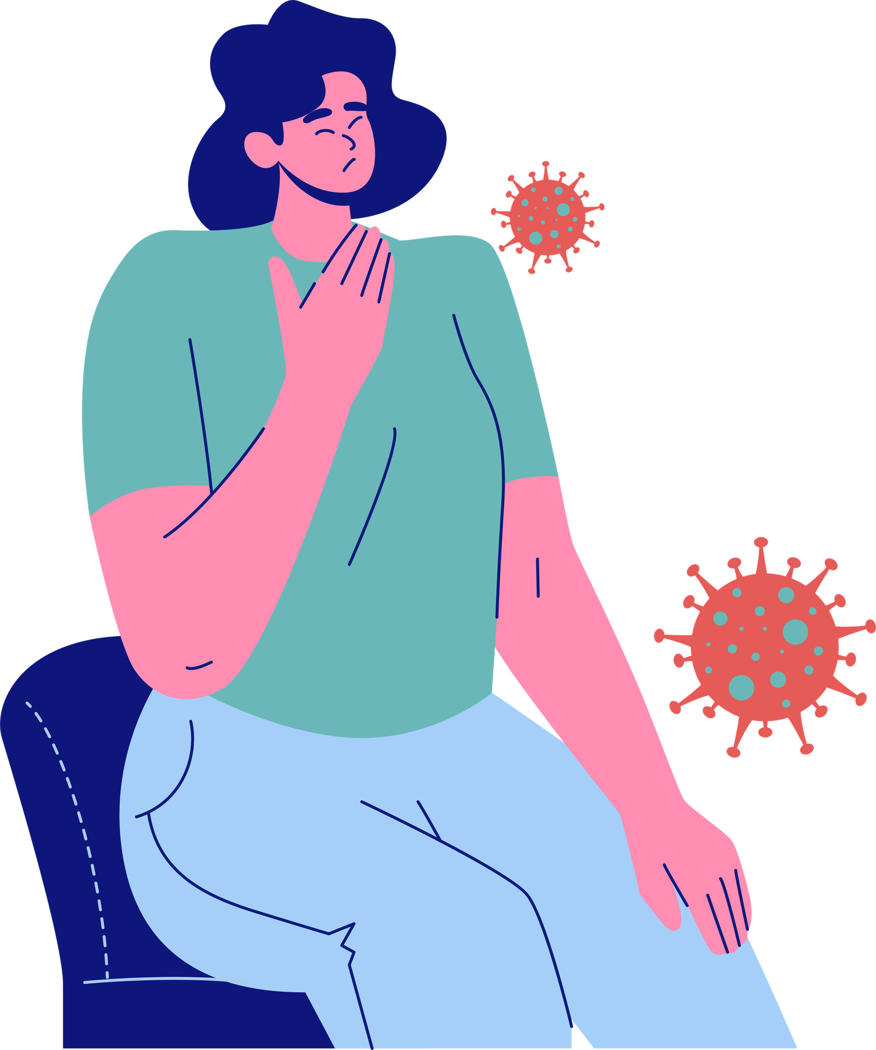
COVID-19 in 2026: Still a Major Threat
Ongoing impact in Europe & Australia
Key facts:
  47,000 new global cases (Jan-Feb 2026)
  63.7% from Europe
  ICU admissions continue in Europe, and Admissions
  COVID-19 remains a leading respiratory cause of death
  Constant variant shifts require vaccine matching
Testing is down, and cases are likely underestimated. COVID-19 now co-circulates with influenza and RSV. It’s not over, only evolving.

Slide 3

Vulnerability: Who is Most at Risk?
Risk is additive, not isolated
High-risk groups:
  Elderly (immunosenescence begins about 50 years)
  Chronic disease and immunocompromised
  Pregnant women
  Conflict and displaced populations
  Aged care residents
  Indigenous peoples
In Europe, high epidemiological risk: Bulgaria, Portugal, Latvia, Greece, showing that southern and eastern Europe have a higher structural vulnerability
Vulnerability = Age + Comorbidities + Poverty + Overcrowding + Weak health systems.

Slide 4
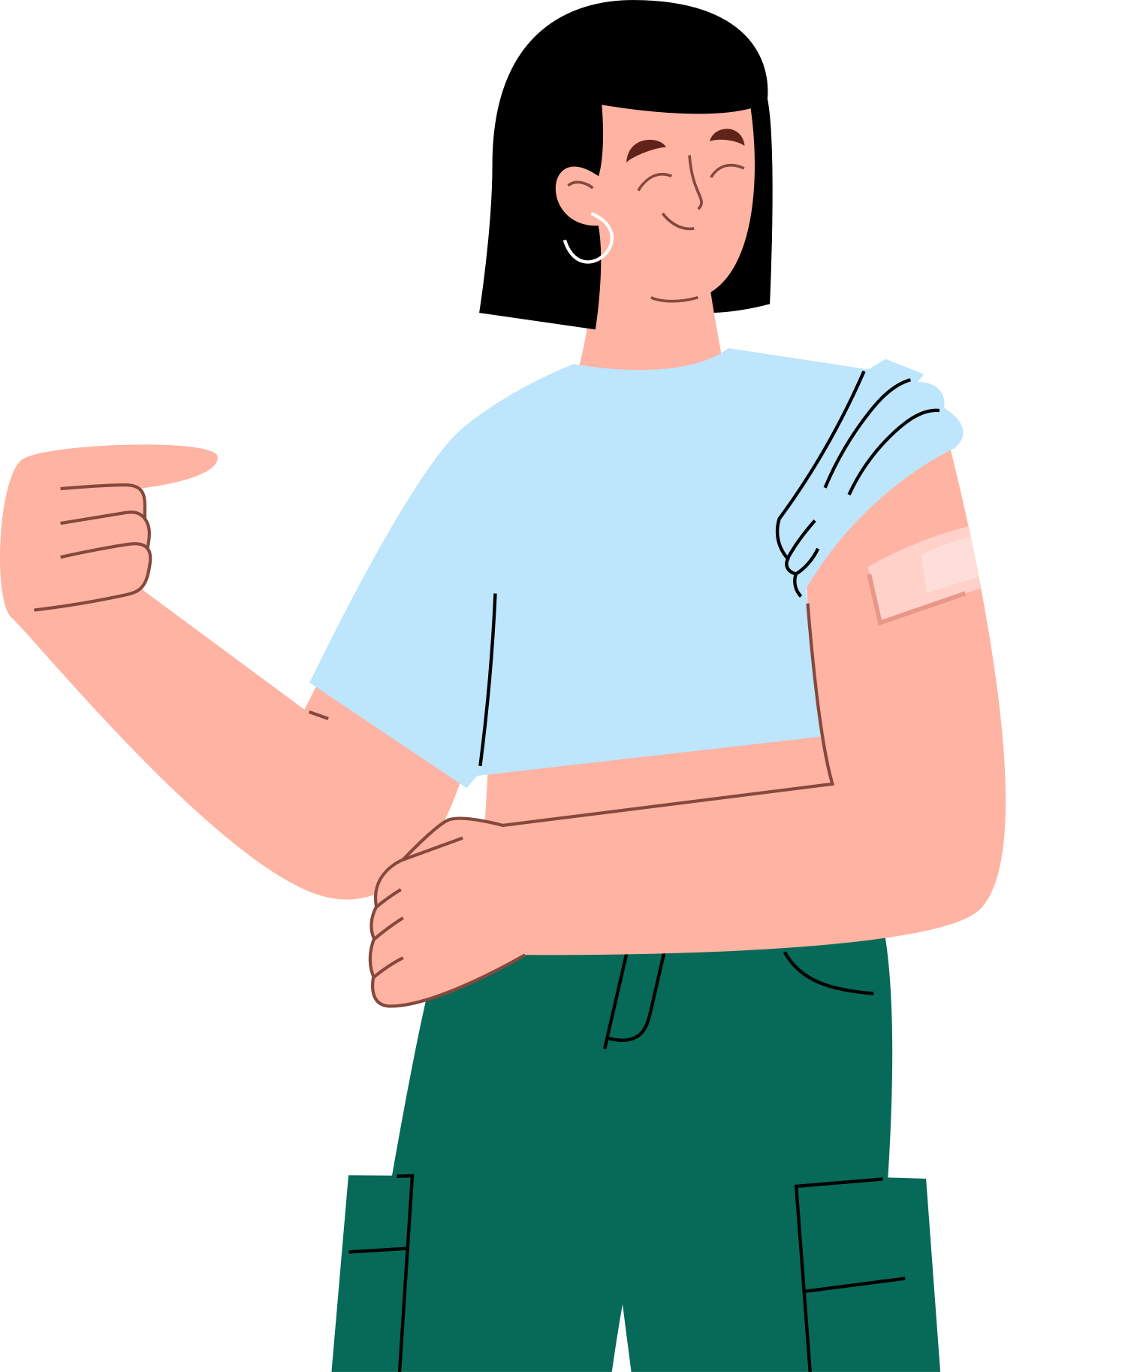
Vaccination: The Decisive Difference
Portugal vs. Bulgaria case study
Same risk profile:
  Similar elderly population
  Similar comorbid burden
  Similar epidemiological risk index
Critical difference:
  Portugal had a very high vaccine uptake → Low excess mortality
  Bulgaria had a very low vaccine uptake → High excess mortality (especially in 2021)
Vaccination dramatically reduces excess mortality. It also reduces Intensive Care Unit (ICU) overload, secondary bacterial infections, antibiotic overuse, and the long COVID-19 burden.

Slide 5
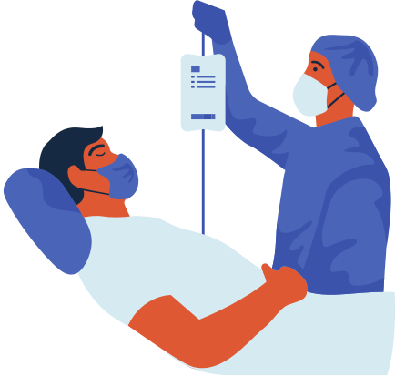
The True Cost of COVID-19
Economic and systemic impact
Global spending
  2017: $7.5 trillion
  2019: $8.5 trillion
  2023: $9.8 trillion
  11-12% per capita overspend (high-income countries)
UK case study:
  About £260 billion total cost
  Only 21% spent on healthcare
  Most funds go to economic survival measures
Beyond money, it leads to health workforce burnout, disrupted services,
long COVID-19 disability, and productivity loss. Vaccination = economic protection.

Slide 6
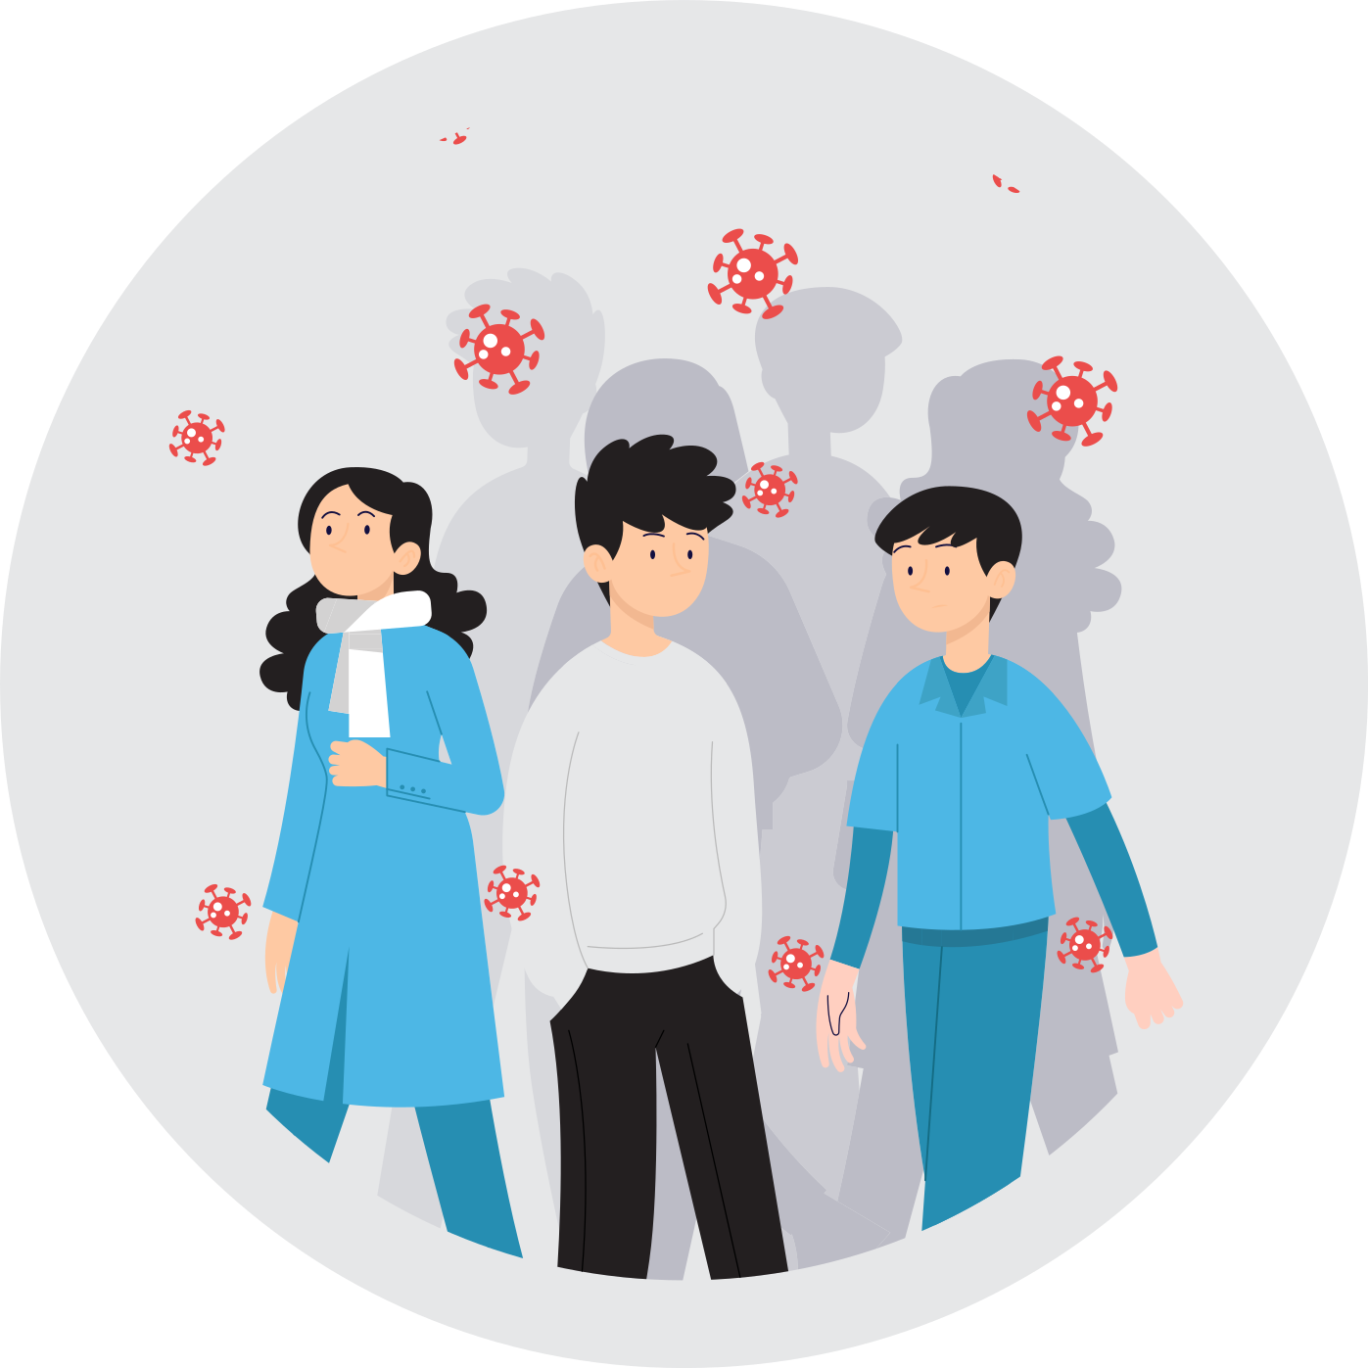
The Path Forward: Resilience and Vaccination
What makes a successful response?
Strengthen health system resilience
  Governance matters
  Fund preparedness plans
  Invest in workforce retention
  Digital health transformation
  Intersectoral “One Health” approach
Improving vaccine uptake requires alignment between the government,
healthcare and public health professionals, the public, and the media.
Healthcare workers are a multiplier effect.
When they protect themselves, they protect patients, and this increases trust.

Slide 7
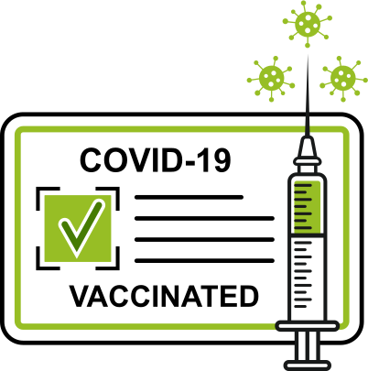
Preparedness Must Become Permanent
Vaccination and resilient health systems means...
  Fewer deaths
  Lower excess mortality
  Less ICU overload
  Reduced antimicrobial resistance
  Stronger economies
COVID-19 remains a structural threat.

